Slide 1

Threats to SOCIAL MEDIA
END USERS
Group 8
Notes:
7. Define and explain types of threats to social media end users (FB/IG/TikTok etc.) why is it important and how can it affect consumers lives?

Slide 2
TABLE OF CONTENTS
01
02
03
04
05
06
GROWING POPULARITY AND SIGNIFICANCE
THREAT SUMMARY
ATTACK LOCATIONS
CASE STUDIES
IMPACT ON CONSUMER LIVES
WAYS TO MITIGATE IMPACT

Slide 3
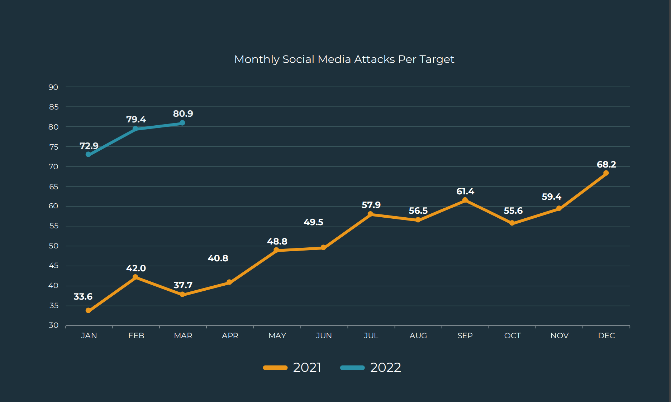
SOCIAL MEDIA ATTACK TRENDS
Attacks per target increased 105% from Q1 2021 to Q1 2022.
[https://www.tripwire.com/state-of-security/top-phishing-social-media-quarterly-threat-trends-intelligence-report]
Notes:
https://www.tripwire.com/state-of-security/top-phishing-social-media-quarterly-threat-trends-intelligence-report

Slide 4
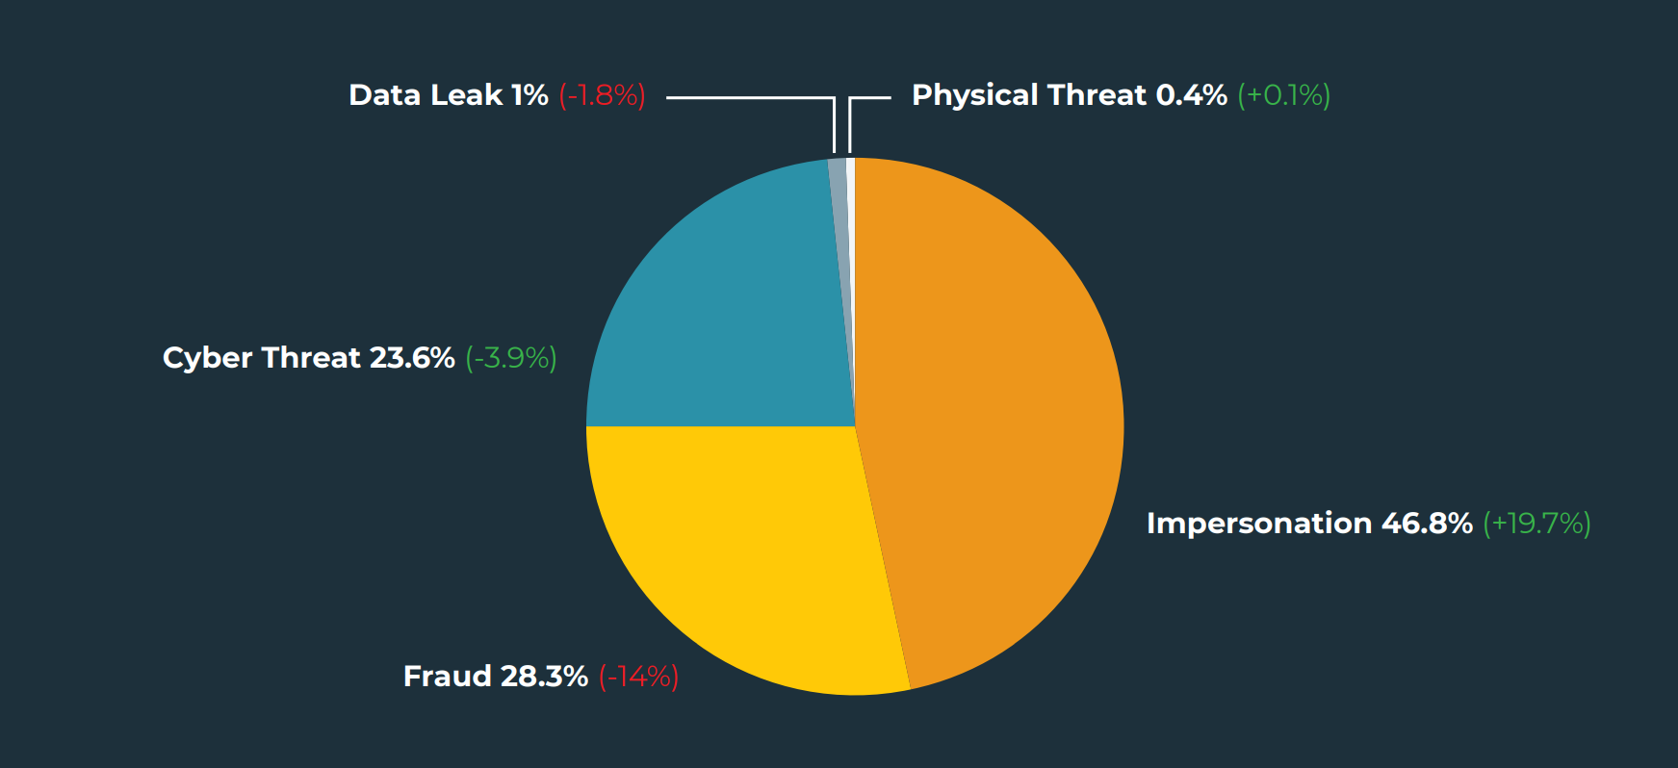
TOP SOCIAL MEDIA THREATS
Top Social Media Threats from Q1 2021 to Q1 2022.
[https://www.tripwire.com/state-of-security/top-phishing-social-media-quarterly-threat-trends-intelligence-report]
Notes:
TOP SOCIAL MEDIA THREATS
In Q1, Impersonation scams surged to represent almost half of all attacks on social media after a 19.7% increase in share from Q4 to Q1.
Impersonation attacks have now seen increases for three consecutive quarters.
Historically, the top threat-type on social media, Fraud experienced a 14% decline in Q1, moving it to the second spot. Fraud represented 28.3% of all social media attacks.
Cyber threats such as hacking experienced a slight decrease in share in Q1, contributing to 23.6% of overall volume.
Data Leaks and Physical Threats were present but minimal, representing 1.0% and 0.4%, respectively. Fraud 28.3% (-14%) Data Leak 1% (-1.8%) Physical Threat 0.4% (+0.1%) Impersonation 46.8% (+19.7%) Cyber Threat 23.6% (-3.9%) Brand and Executive Impersonations increased significantly in Q1, rising in count and share for 3 consecutive quarters.

Slide 5
TYPES OF CYBER THREATS TO SOCIAL MEDIA END USERS
IMPERSONATION SCAMS
PHISHING
Criminals act as trustworth entities such as government officials to deceive victims into sharing sensitive information or transfer funds. Eg. A scam email pretending to be a senior executive asking for a funds transfer.
Cybercriminals impersonate reputable social media platforms to lure victims into revealing their credentials on fake websites.
FRAUD
DATA BREACH
Criminals use stolen identity to open bank accounts, credit cards, take loans or conduct online scams that trick individuals into losing money or sensitive information.
A data leak can happen when attackers find a way to access data stored in databases.This can be through poor database security configuration or leaked authorization tokens.
CYBER THREAT
SOCIAL ENGINEERING
Cyber threat is a potential malicious act that seeks to damage data, steal data, or disrupt digital life in general. This includes threats like malware, phishing, and denial-of-service attacks which exploit vulnerabilities in technology to cause harm.
It is the act of manipulation of individuals to divulge confidential information or perform actions that would compromise security. When applied to a person of high privilege or importance, it can potentially be very dangerous
Notes:
https://www.pandasecurity.com/en/mediacenter/social-media-threats/
https://us.norton.com/blog/emerging-threats/social-media-threats

Slide 6
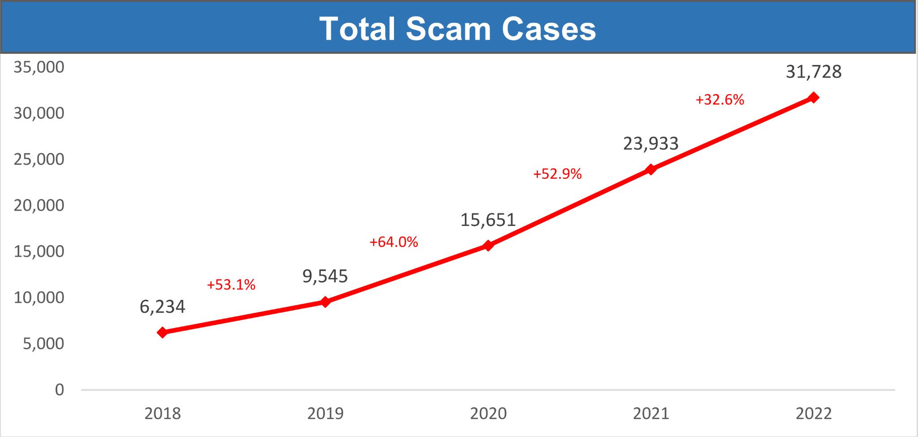
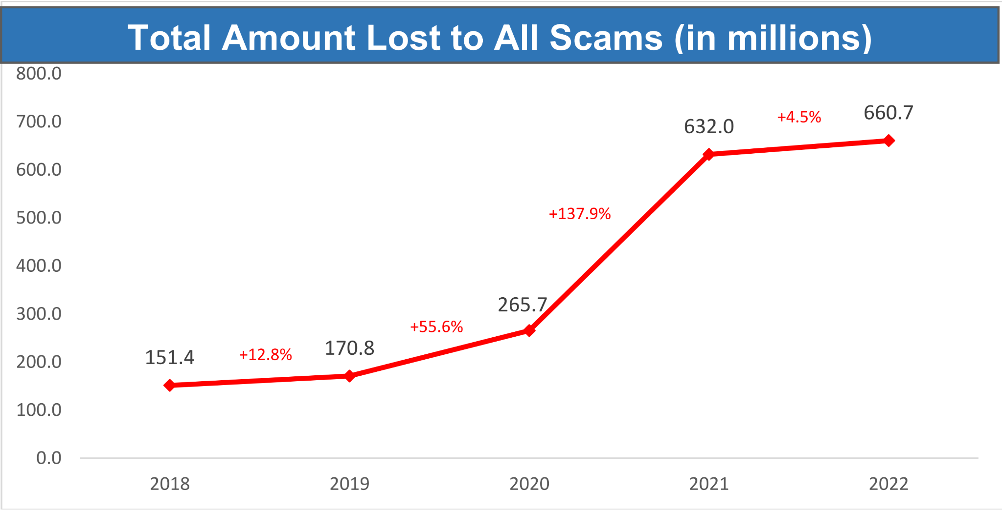
Increasing Trend of Impersonation Scam in Singapore
The total number of scam cases in Singapore increased by 32.6% to 31,728 in 2022 as compared to 2021.
The total amount reported to have been cheated from all scams increased by 4.5% from $632.0 million in 2021, to $660.7 million in 2022.
(If dont have the exact values for the cash amt 4.5% doesnt seem v significant)

Slide 7
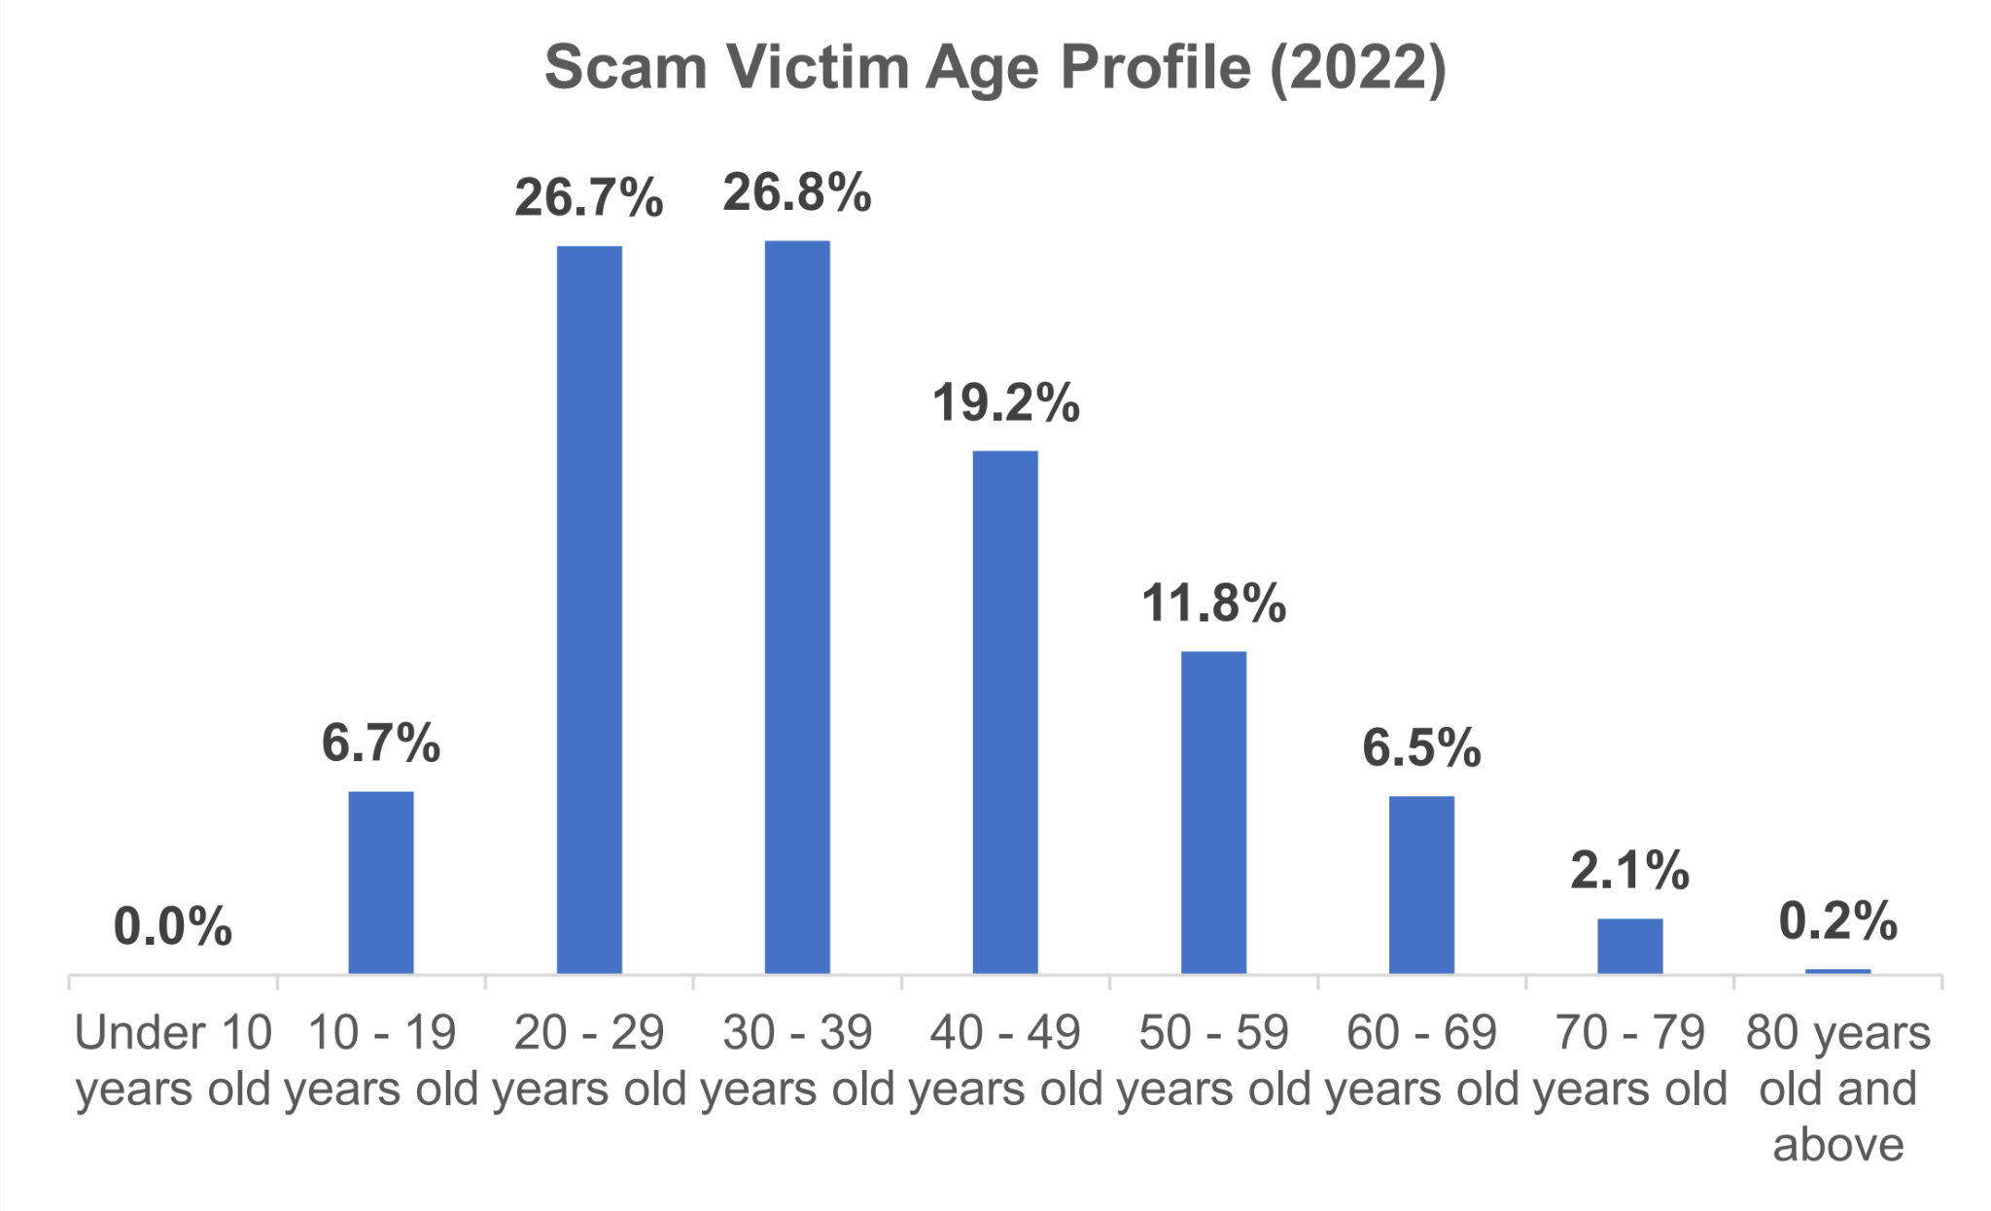
Distribution of Scam Victims

Slide 8
Data breaches on social media platforms rank among the largest recorded data breaches.
In 2019, Facebook had 540 million user records exposed on the Amazon cloud server.
Social media data breaches accounted for 56% of data breaches in the first half of 2018.
In 2016, the AdultFriendFinder network was hacked, exposing 412 million users’ private data.
Notes:
Social media data breaches accounted for 56% of data breaches in the first half of 2018.
In 2019, Facebook had 540 million user records exposed on the Amazon cloud server (CBS).
In 2016, the AdultFriendFinder network was hacked, exposing 412 million users’ private data (ID Strong).
https://www.varonis.com/blog/data-breach-statistics

Slide 9

Case Study 1: Tik Tok (Cyber Threat)

Slide 10
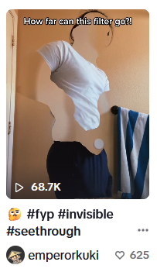

Tik Tok
Invisible filter remover (Trojan)
Notes:
For this presentation, one of the case studies we will review is related to a filter challenge that was happening in Tiktok, where users were challenged to go naked and pose in front of the filter that will remove their nude body. Users were looking for ways to remove the filter so that they could see the actual naked bodies of those that were using this invisible filter.
The hackers then capitalized this trending TikTok challenge to install malware on thousands of devices and steal their data. TikTok videos that claim to offer a special "unfiltering" filter to remove TikTok's body masking effect and expose the TikTokers' nude bodies were posted, alongside instructions of how to acquire the filter removing tool.

Slide 11
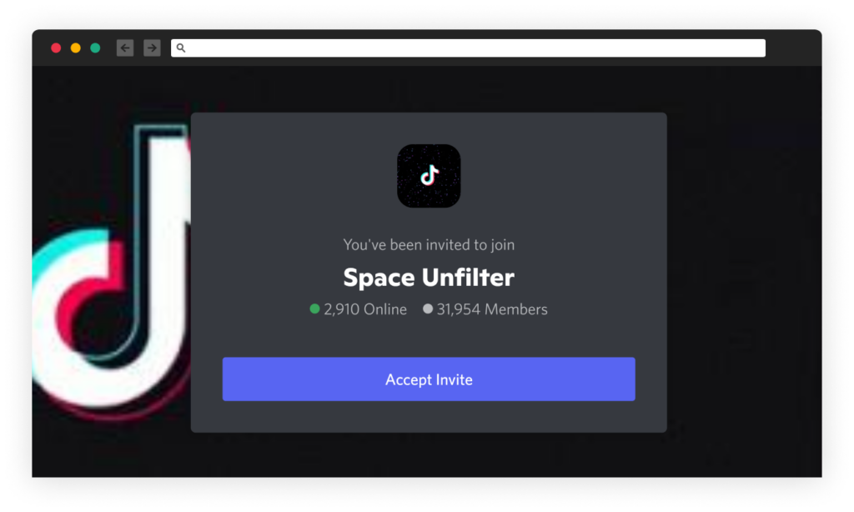
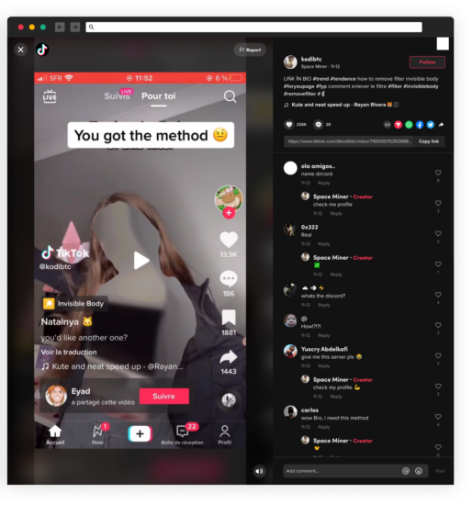
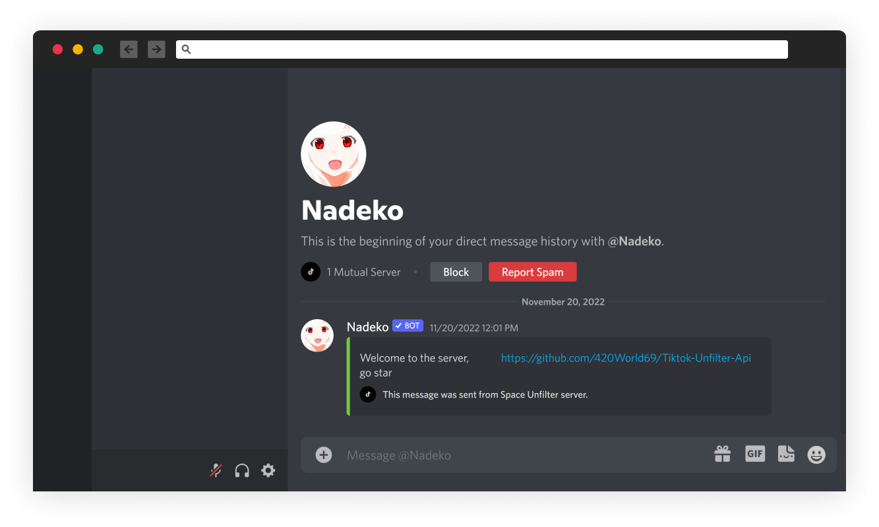
TikTok Filter Removal
Notes:
The TikTok users @learncyber and @kodibtc posted videos on TikTok (over 1,000,000 views combined) to promote a software app able to “remove filter invisible body“ with an invite link to join a Discord server called “Space Unfilter” to get it.
Once you click the invite and join the Discord server “Space Unfilter,” there are NSFW videos uploaded by the attacker, claimed to be the result of his “unfilter” software. An attempt to include sample videos as proof to trick users agree to install his software.
In addition, a bot account, “Nadeko,” automatically sends a private message with a request to star the GitHub repository 420World69/Tiktok-Unfilter-Api.

Slide 12
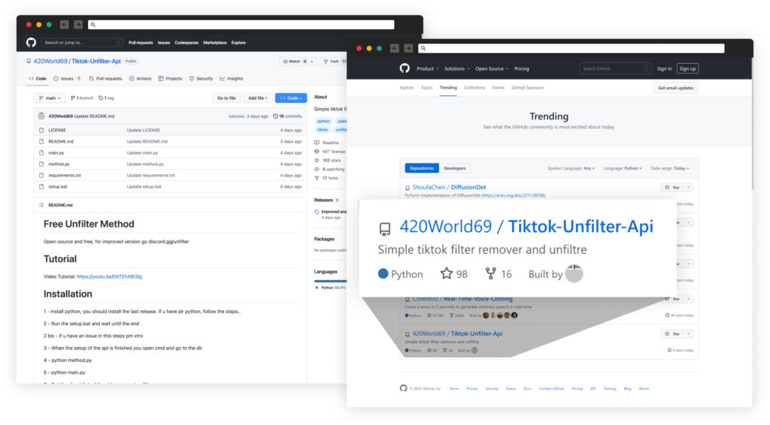
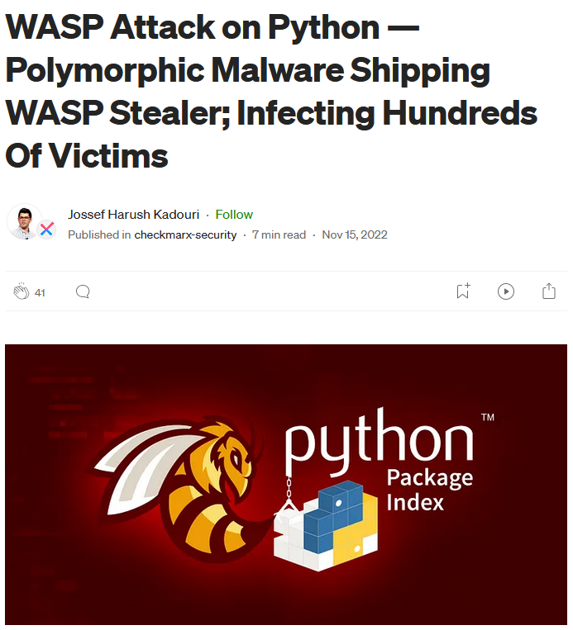
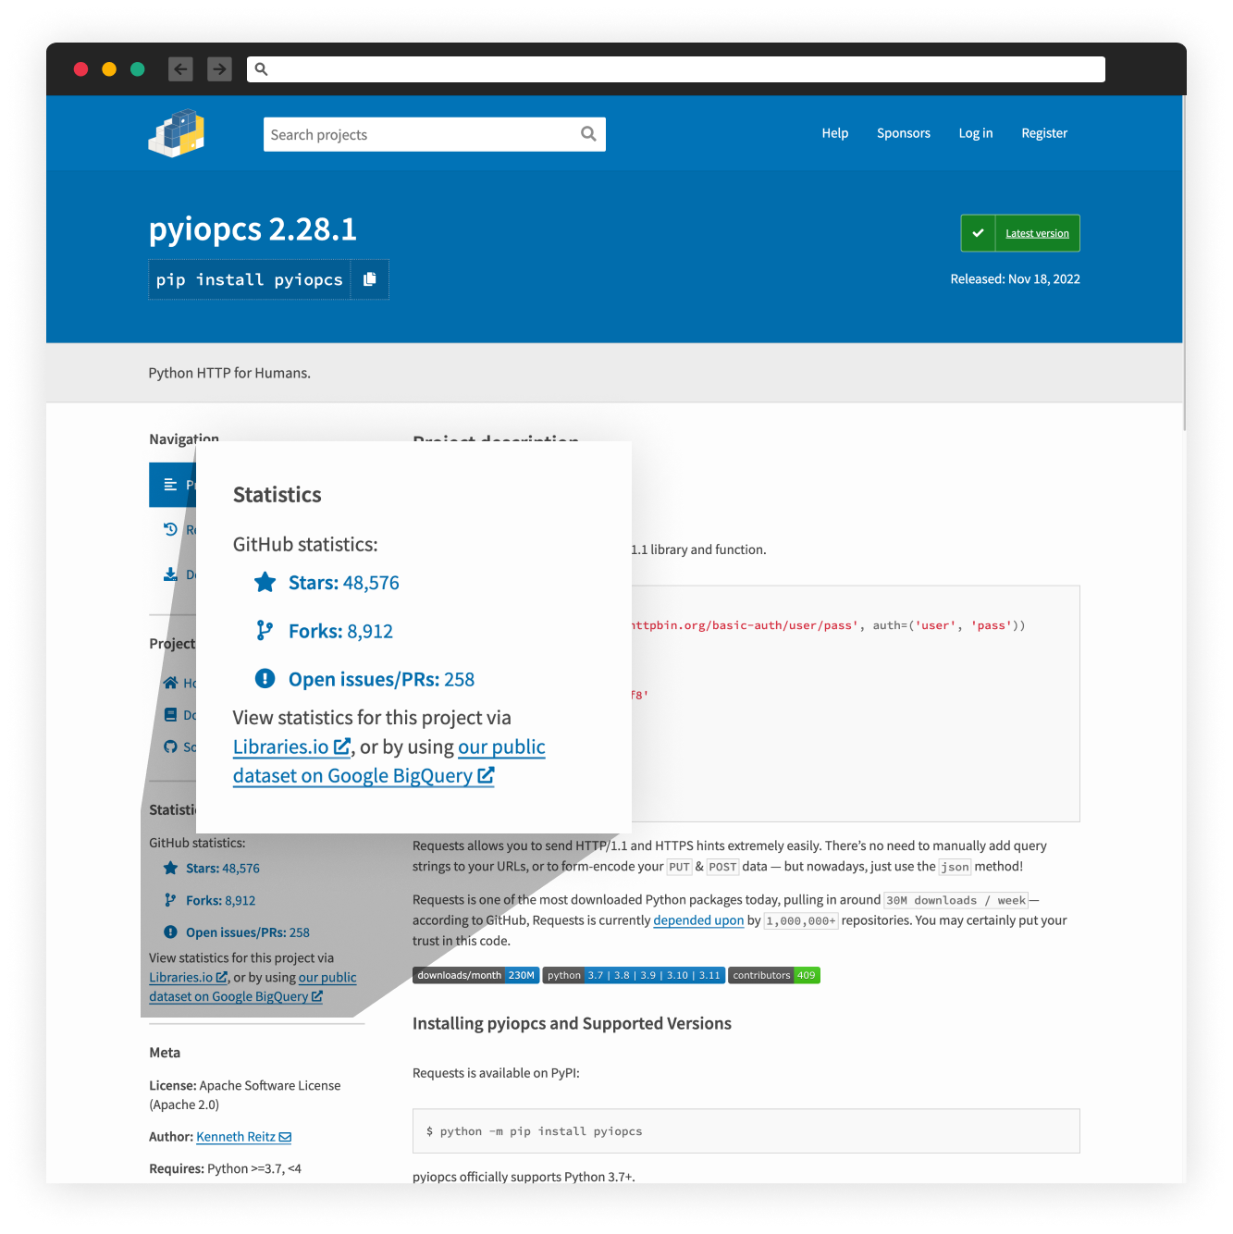
Using Github for Phishing
Notes:
This GitHub repository 420World69/Tiktok-Unfilter-Api represent itself as an open-source tool that can remove the invisible body effect trending on TikTok and currently has 103 starts and 17 forks, through which he gained the status of a trending GitHub project.
This is where the user can download the malware posing as a useful tool to use.
Inside this project’s files is a .bat script that installs a malicious Python package listed in the requirements.txt file.
Looking at the project’s history, the attacker used “pyshftuler”, a malicious package, but once it was reported and removed by PyPi, the attacker uploaded a new malicious package under a different name, “pyiopcs”. This latest package was also reported and removed, and he had yet to update his code.
This package contains sources to malicious code that, when run, can stealing all the victim’s Discord accounts, passwords, crypto wallets, credit cards, and other interesting files on the victim’s PC and sends them back to the attacker through a hard-coded Discord webhook address. (Webhooks are automated messages sent from apps when something happens.)
Other info: The project files contained a Windows batch file (.bat) that, when executed, installs a malicious Python package (WASP downloader) and a ReadMe file that links to a YouTube video containing instructions on installing the TikTok "unfilter" tool.
Checkmarx analysts discovered that the attackers used multiple Python packages hosted on PyPI, including "tiktok-filter-api", "pyshftuler", "pyiopcs," and "pydesings," with new ones added every time the old packages are reported and removed.
Also, the attackers use the "StarJacking" technique on PyPI, linking their project to a popular GitHub project they have no association with to make it appear legitimate.
https://www.bleepingcomputer.com/news/security/tiktok-invisible-body-challenge-exploited-to-push-malware/
https://checkmarx.com/blog/attacker-uses-a-popular-tiktok-challenge-to-lure-users-into-installing-malicious-package/
https://medium.com/checkmarx-security/attacker-uses-a-popular-tiktok-challenge-to-lure-users-into-installing-malicious-package-fe6248dfe0ae

Slide 13
Cyber Kill Chain
Reconnaissance
Target trending TikTok challenge
Weaponisation
Hide WASP downloader in Github project files
Delivery
Attacker create TikTok videos to promote Discord channel

Slide 14
Cyber Kill Chain
Exploitation
Users run the program files that have a malicious Windows batch file
Installation
Installs malicious Python package (WASP downloader)
C2
Establish connection to attacker
Actions on Objectives
Steal Discord tokens, passwords, credit card info, etc.

Slide 15
TTP
Tactic | Technique | Procedure
Initial Access | Phishing (T1566) | Social Engineering using TikTok videos
Execution | User execution (T1204) | Running the program files
Defense Evasion | Obfuscated Files or Information (T1027)
 | Masquerading (T1036)
Collection | Data from local system (T1005) | Passwords, Discord accounts, and, potentially, cryptocurrency wallets.
Exfiltration | Exfiltration Over Web Service (T1567) | Uses hard-coded Discord webhook address

Slide 16
ADVERSARIES
TikTok users @learncyber and @kodibtc
Bot account, “Nadeko,” on discord.
Threat actors seems to be after financial gains. Exploited existing malware to gather user data.
CAPABILITIES
TikTok Invisible filter remover malware
INFRASTRUCTURE
Data extraction
Phising
Social engineering
Used existing github and malware python library.
Used API in github and other already available phishing tools
VICTIMS
The threat actors have since moved this Discord server, but Checkmarx states that they had approximately 32,000 members at one point.

Slide 17
Case Study 2: Twitter API Data Breach

Slide 18
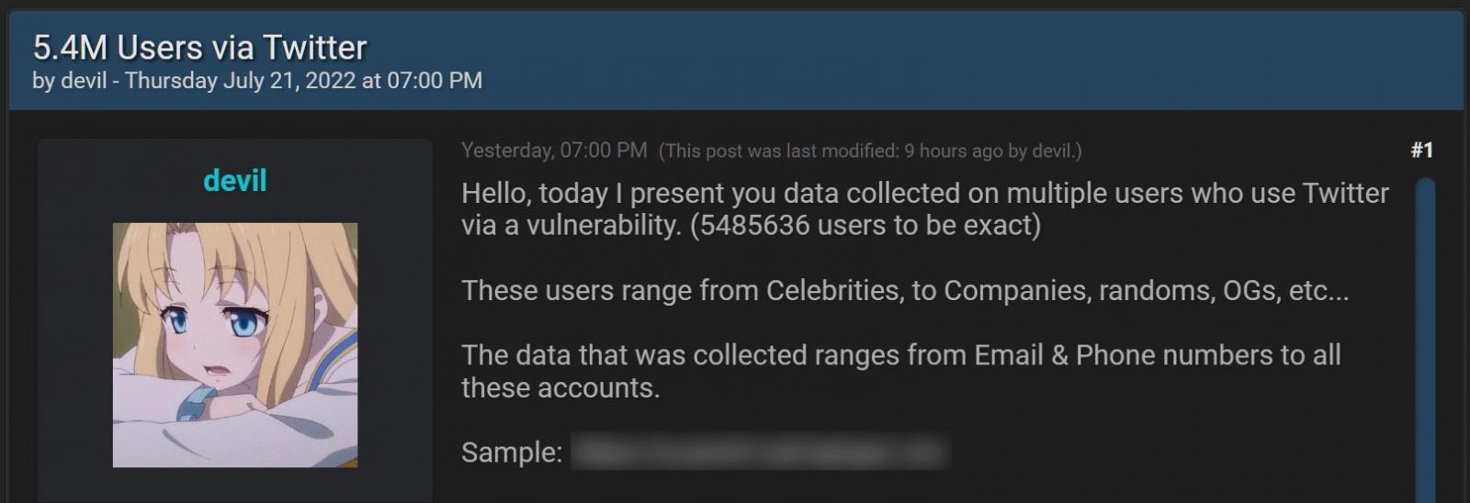
Twitter DATA BREACH
Data stolen
The data was initially sold by a threat actor on hacking forum for $30,000 in July 2022.
But information was later shared for free on a forum by another user.
[https://www.bleepingcomputer.com/news/security/54-million-twitter-users-stolen-data-leaked-online-more-shared-privately/]
Notes:
November 24th, the 5.4 million Twitter records have now been shared for free on a hacking forum by a user named Trapped in darkness.
https://www.bleepingcomputer.com/news/security/54-million-twitter-users-stolen-data-leaked-online-more-shared-privately/

Slide 19
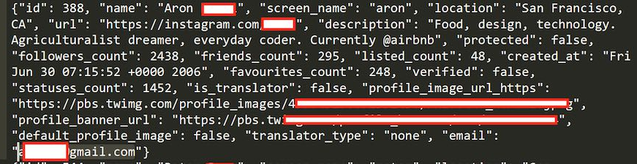
Twitter Excessive API Data Exposure
How did it happened?
Twitter API vulnerability that allowed people to submit phone numbers and email addresses into the API to retrieve the associated Twitter ID.
Using this ID, the threat actors could then scrape public information about the account to create a user record containing both private and public information.
[https://restoreprivacy.com/twitter-vulnerability-exposes-5-million-accounts/]

Slide 20
ADVERSARIES
Threat actor ‘devil’: Motivation is
Financial gain, attempted to sell stolen data for $30,000
CAPABILITIES
INFRASTRUCTURE
Twitter data breach
Data extraction
Data distribution
Social engineering
Utilizing BreachForums to sell the data.
VICTIMS
Affected users: ~5.4 million twitter users
Notes:
January 2023: Database of Over 200m Twitter Users Goes Public
Following a string of ransom attempts and leaks, a trove of data on over 200 million Twitter users circulated among hackers in December 2022, and was published in full on BreachForums on January 4th. This data includes email addresses, names, and usernames, but does not appear to include passwords or other highly sensitive data.
This data was originally scraped by exploiting an API vulnerability that persisted from June 2021 to January 2022. This vulnerability was exploited repeatedly by different hackers, and resulted in multiple ransomware attempts and leaks in the latter half of 2022. Most recently, a hacker known as Ryushi attempted to ransom the data for $200,000 in late December
Vulnerability: Twitter’s API served as the primary entry point for the adversary to access user data

Slide 21
Cyber Kill Chain
Reconnaissance
Gather information about Twitter’s systems, applications and potential vulnerabilities
Weaponisation
Attacker identified vulnerability in Twitter API
Delivery
Attacker initiates attack by submitting request to the vulnerable API
Notes:
Weaponization: Attacker identified vulnerability in Twitter API and exploit this vulnerability
Delivery:

Slide 22
Cyber Kill Chain
Exploitation
Attackers used retrieved ID from API to scrape public/private information of the account
Actions on Objectives
Steal users’ personal information such as phone number, email etc.

Slide 23
Impacts on consumer lives
Privacy violations
Identity theft
Unauthorized access to private and personal data such as text messages or photos, as well as medical records. This breach may unveil embarrassing information, potentially leading to reputational harm for individuals involved.
Fraud: Stolen identities can be used to commit fraud, open bank accounts or obtain credit cards.
Reputation: Criminals use stolen identities to conduct further scams, resulting in personal reputational damage and distress
Monetary Loss
Misinformation/Fake news
Direct Theft: Downloading malware through social media phishing can lead to draining of bank accounts or payment of ransoms due to ransomware
Spread of false information on social media can have a real-world consequences, such as misinformation about elections

Slide 24
Ways to mitigate impacts
STAY INFORMED
Read about prevalent scam tactics reported in the news.
Being aware of the modus operandi of these threats helps in recognizing red flags of suspicious activity.
PROFESSIONAL || PRIVATE
Separate devices and accounts for professional and personal use.
This lowers the risk of exposing crucial and sensitive information while allowing for simplified privacy management of day-to-day personal use
INVESTING IN CYBERSECURITY
Software firms need to continuously invest and make cybersecurity efforts a priority.
These efforts include: Investing in real-time threat intelligence, upgrading infrastructure, building a strong cybersecurity team, having data protection safeguards and strategies
Notes:
Criminals are always coming up with new ways to scam and earn a quick buck. There is no real one size fits all solution. What’s important is to stay informed about what are the most prevalent and notorious scams currently, dive deeper into the news articles talking about scams. Knowing how the scams work will allow users to pick up on tell-tale signs and allow them to be more resilient towards the scams in general

Slide 25

Thank you
End of presentation.
Q&A
Please keep this slide for attribution

